Slide 1

Prediction of Air Pollution Levels - London
Rahul Mahimkar
Data Scientist

Slide 2
Case Study Presentation
-by Rahul Mahimkar
Introduction AQI
Problem statement, Data Source, Deliverables
Data Collection
Approach
Code Repository, Jupyter Notebook
Unit Test
Output Files
Future work and Improvements
Conclusion

Slide 3
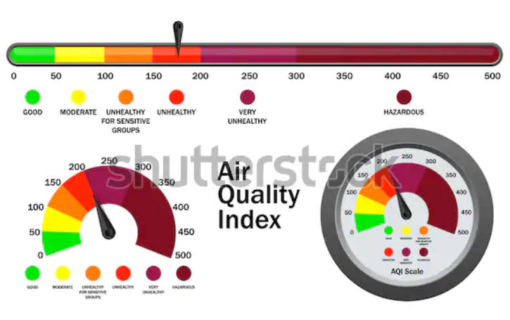
AQI
Air Quality Index (AQI) helps in understanding the level at which air is polluted and the associated health effects that might concern.
An air quality index (AQI) is used by government agencies to communicate to the public how polluted he air currently is or how polluted it is forecast to become
Different countries have their own air quality indices, corresponding to different national air quality standards
In this scope we are going to work on Central London Air pollution data

Slide 4



Problem Statement
Predict the levels of CO, NO, PM10 and PM2.5 in Central London for the next 30 minutes
Data Source
http://www.londonair.org.uk/LondonAir/API/
Expected Deliverables
Good documentation explaining way of thinking
Code Repository
Code as script or Jupyter notebook commented
Unit tests
Future work and improvements
Note : CO data is not available at the source website

Slide 5

Data Collection
City of London data has been considered for this case study
- 15 min averaging period
- PM 2.5 Particulates (PM2.5) – 2 years data, 17th July 2018 to 16th July 2020
- PM 10 Particulates (PM10) – 1.5 years data, 17th Dec 2018 to 16th July 2020 , not able to
extract entire 2 years data, hence restricted to 1.5 years data
- Nitric Oxide (NO) – 2 years data, 17th July 2018 to 16th July 2020
- Carbon Monoxide (CO) – data not available
- Band Threshold – User is allowed to specify the threshold levels for each species in csv file

Slide 6

Approach
- Individual Model development for each Species i.e. PM2.5, PM10 and NO
- 3 Models, Linear Regression, Neural Network and XGBoost for each Species and choose
the best performing model out of 3 models
- Consider only 2 instances of minutes interval i.e. 00 and 30 minutes, for example if we
know the readings at 6 hour 00 minutes then we can predict the readings for 6 hours 30
minutes, If we know the readings for 6 hours 30 minutes then we can predict the readings for
7 hours 00 minutes, so in this use case we have considered only 00 and 30 minutes data for
study purpose , which means that we are not looking at 15 and 45 minutes data points
- Plot Histogram and Scatter plot to understand the data association and outliers, ideally IQR
can also be used for outlier detection but this technique eliminates lot of data points in this use
case hence visualization technique has been chosen for outlier detection in this use case

Slide 7
Approach… continue…
- Outliers
Exclude values > 100 for PM 2.5
Exclude values > 200 for PM 10
Exclude values > 650 for NO
In Jupyter notebook its clearly mentioned the score we achieved before outlier removal and
post outlier removal
- Create some features i.e. add 12 previous values features which would be used in our
training process
- Use only relevant features and start model building ( 3 models for each species )
- Choose the best performing model and output the test data actual values and predicted
values in CSV file i.e. individual actual vs predicted output csv file for each species
Note : Detail technical approach can be found in Jupyter Notebook as it’s a well commented notebook

Slide 8

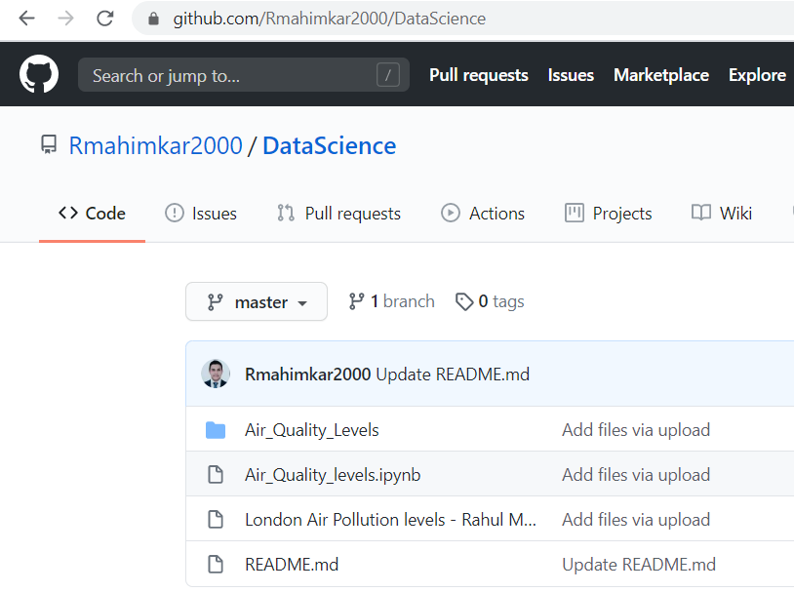
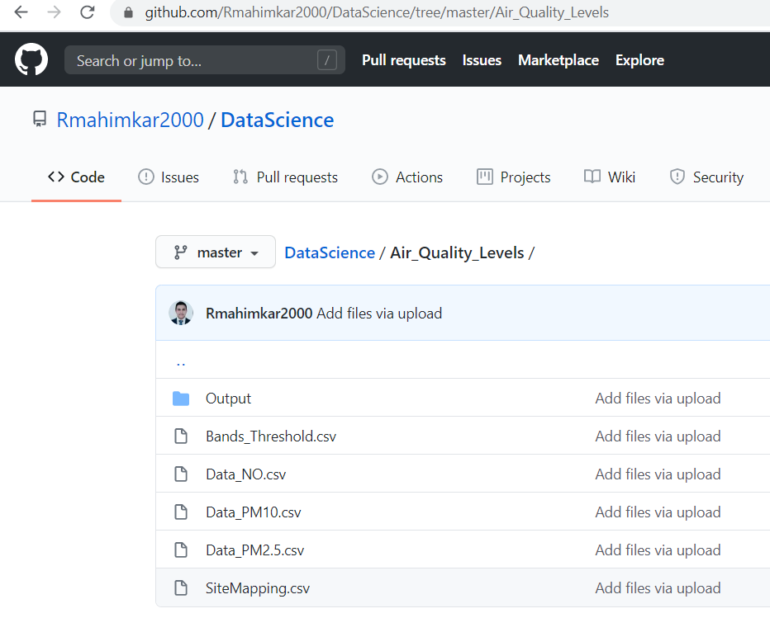

Code Repository
- GitHub Link
https://github.com/Rmahimkar2000/DataScience
Jupyter Notebook code
- Jupyter Notebook
“Air_Quality_levels.ipynb”

Slide 9

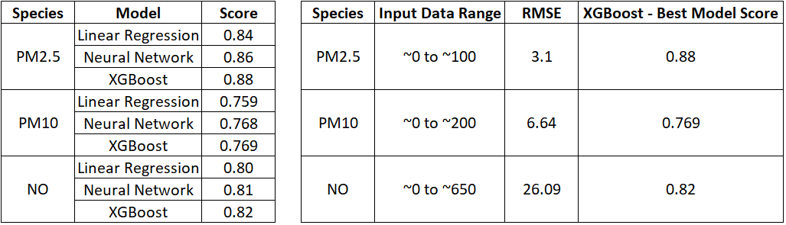
Unit test
- Model Evaluation
RMSE and Score (R squared)
XGBoost seems to deliver better results for each of the species

Slide 10
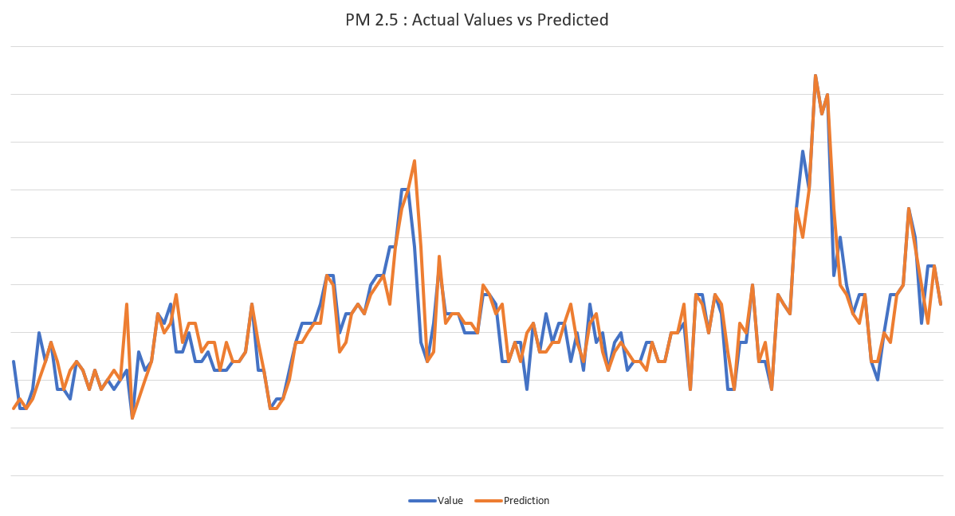
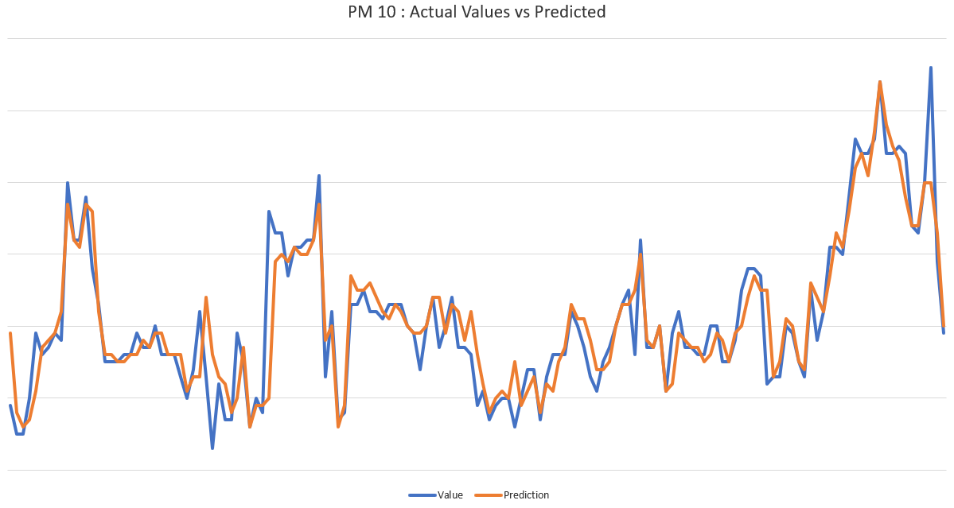
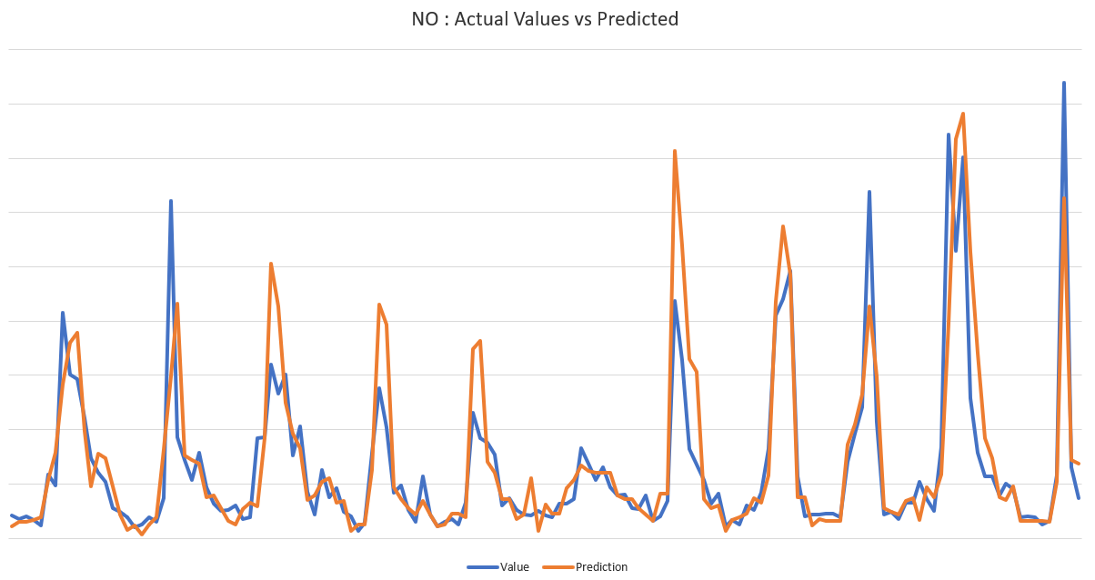
Unit test .. continue..
Actual Values vs Predicted

Slide 11

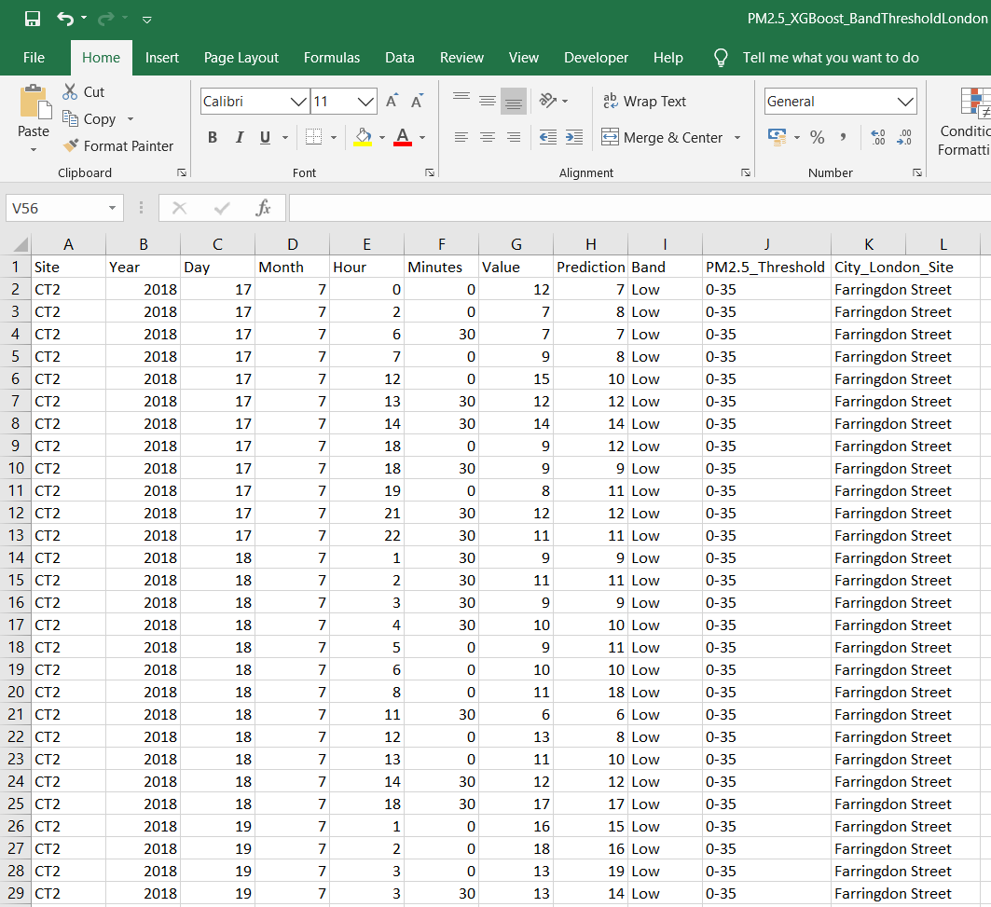
Output files
- PM2.5_XGBoost_BandThresholdLondon csv output file
- PM10_XGBoost_BandThresholdLondon csv output file
- NO_XGBoost_BandThresholdLondon csv output file
Partial screen of how the output csv file looks like:

Slide 12

Future work and Improvements
Below are the few scope of work which can further bring some improvements in our case study
- Time series ARIMA model
Time series analyses may be use to extract the relevant information and it can be use to
predict the future trend
- Deep RNN Recurrent Neural Network based on LSTM Long Short Term Memory
RNN LSTM is a popular deep learning architecture that is used to model sequential data. It
contains cyclic connections where the outputs from previous time steps are fed as input to
the current time step
- Additional new features via data collection

Slide 13


Conclusion
This Model is ready to use which would take the 30 minutes interval historical data as input and would predict the air pollution levels for the next 30 mins with a very good accuracy and pretty good RMSE metric

Slide 14


